Slide 1

Phylogenetic Analysis of Lactobacillus spp.
Using nf-core/phyloplace Pipeline
Advanced Bioinformatics (BCHM5420)
University of Lethbridge
Ajay Poudel

Slide 2
Contents
Background information
Your research question & hypothesis
Analysis and Methods
Results and Visualizations
Discussion
Limitations & Caveats

Slide 3
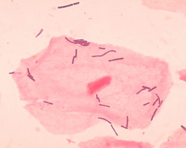
1. Background information
Lactobacilli are bacteria that colonised human and animal body sites, such as the digestive tract and the female genital tract.
Lactobacilli are among the most common probiotic found in food (such as yogurt),
Lactobacillus sp. near a squamous epithelial cell.
Source: Lactobacillus (Wikipedia).

Slide 4

The bioinformatic tools that my project will be focusing:
The pipeline is built using Nextflow.
It uses Docker/Singularity containers making installation trivial and results highly reproducible
Conda as a last resort i.e. when it’s not possible to run the pipeline with Docker, Singularity, Podman, Shifter or Charliecloud.

Slide 5
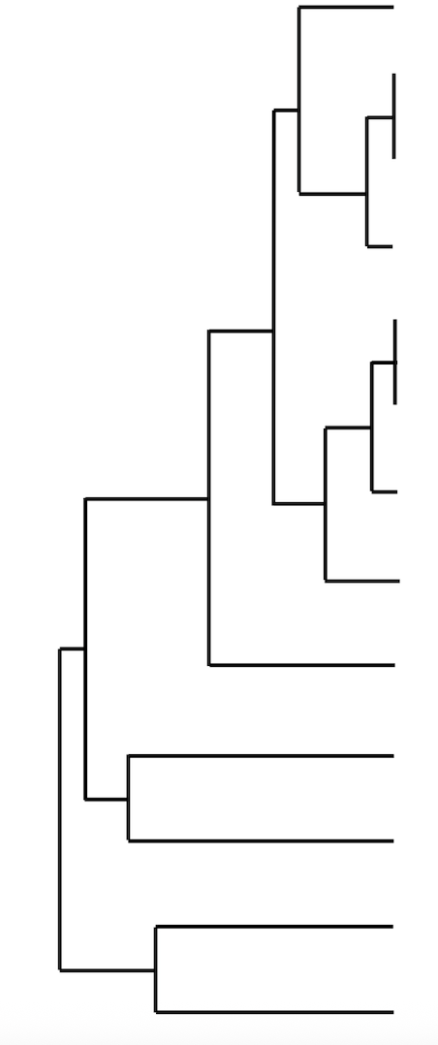
Uses of nf-core/phyloplace
This pipeline performs phylogenetic placement by individually mapping query sequences onto a reference tree based on likelihood.
It avoids reconstructing a full phylogeny, making it ideal for short sequences (e.g., PCR amplicons, metagenomic fragments)
It is also useful for large sequence datasets.
The final output includes a complete tree with both reference and query sequences, where queries are inserted at their most likely positions.

Slide 6
2. Research question & hypothesis
Research Question:
How do my Lactobacillus query sequences relate phylogenetically to known Lactobacillus reference sequence within an established reference tree?
(This will let us know whether my query isolates fall within known clades or form distinct lineages when placed on a curated phylogeny.)
Hypothesis :
Genomic analysis of Lactobacillus using nf core/phyloplace will enable accurate phylogenetic placement and reveal distinct clustering that reflect their evolutionary relationships.

Slide 7
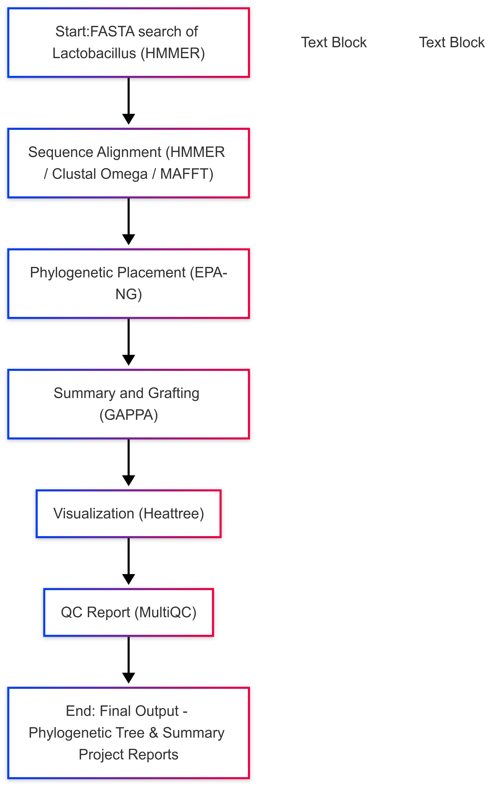
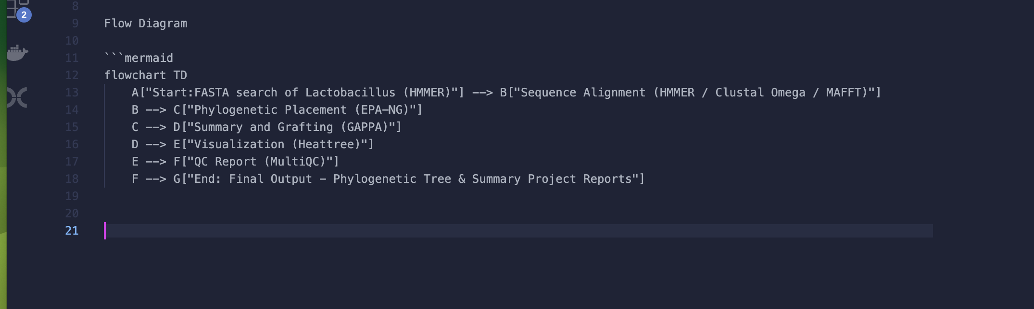
3. Analysis and Methods

Slide 8
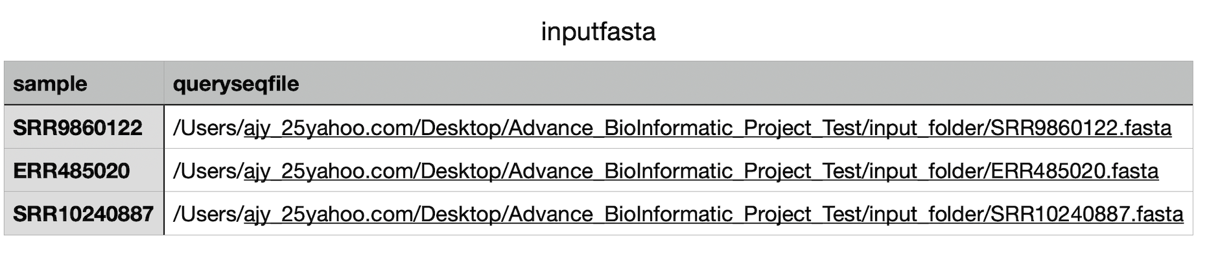
Step 1: download In-put files
Using the command line, downloaded three FASTA files (Illumina platform).
Then created a .csv file listing all three FASTA files.
Two Lactobacillus genomes were selected as query sequences
One genome was designated as the reference.
CSV file

Slide 9
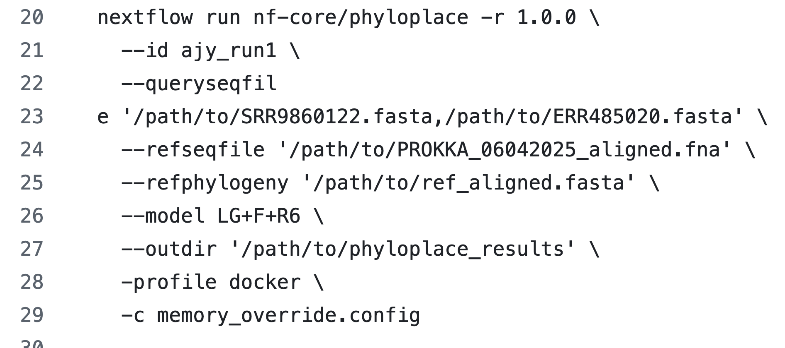
2. Pipeline Command Used

Slide 10
Input Parameters
Parameter | Function / Description
-r 1.0.0 | Specifies version of the nf-core/phyloplace pipeline to run
--id ajy_run1 | Assigns a unique identifier (ajy_run1) to pipeline. Helpful for labeling outputs / logs.
--queryseqfile '/path/to/SRR9860122.fasta,/path/to/ERR485020.fasta' | Query sequences file(s). FASTA files separated by a comma inside one string.
----refseqfile '/path/to/PROKKA_06042025_aligned.fna' | Reference file, a MSA of known Lactobacillus.Query sequences will be compared/placed against this reference.

Slide 11
--refphylogeny '/path/to/tree' | reference phylogeny tree file. use this tree to place query into phylogenetic context.
--model 'LG+F+R6' | specifies the evolutionary model for sequence analysis. pipeline will use this model during phylogenetic placement.
--outdir '/path/to/phyloplace_results' | sets the directory where all results, logs will be saved.
-profile docker | tells Nextflow to use Docker containers to run the pipeline
-c memory_override.config | loads a custom Nextflow config file named memory_override.config. usually used to override default resource settings like memory, CPU, or runtime for certain steps.

Slide 12
4. Results and Visualizations

Slide 13
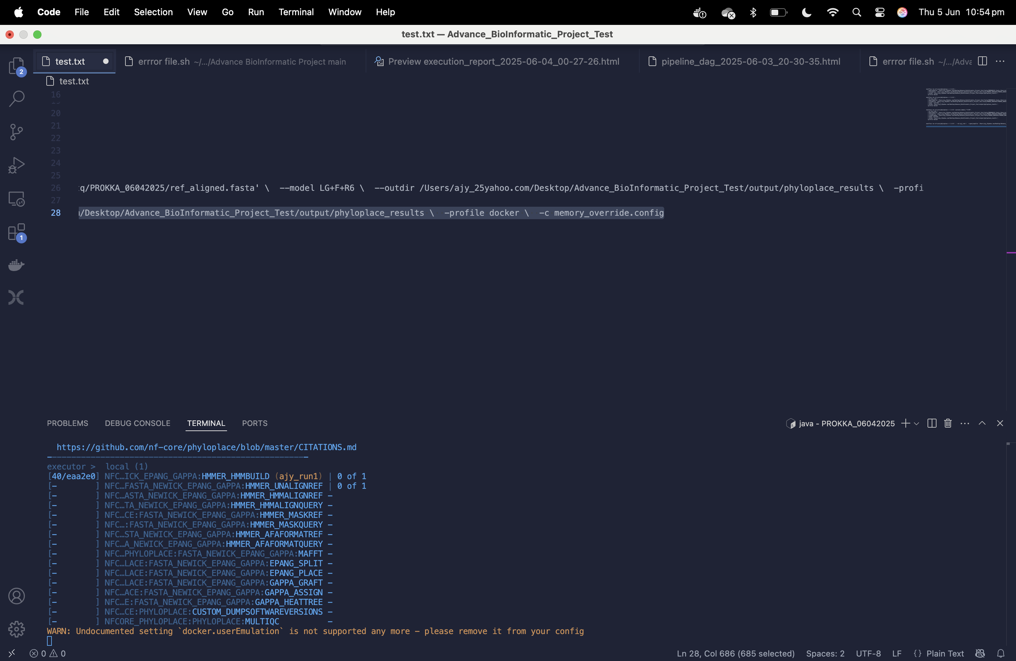

Slide 14
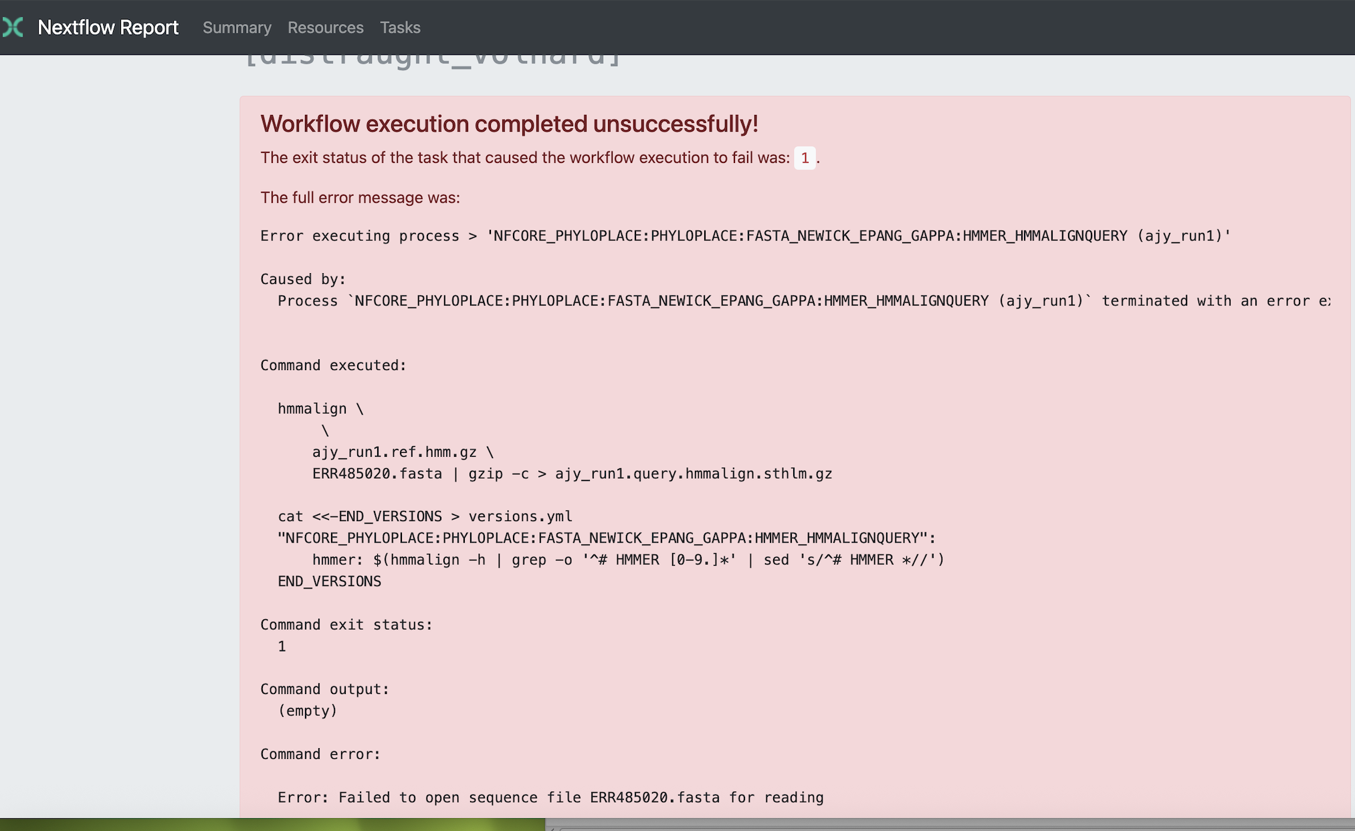

Slide 15
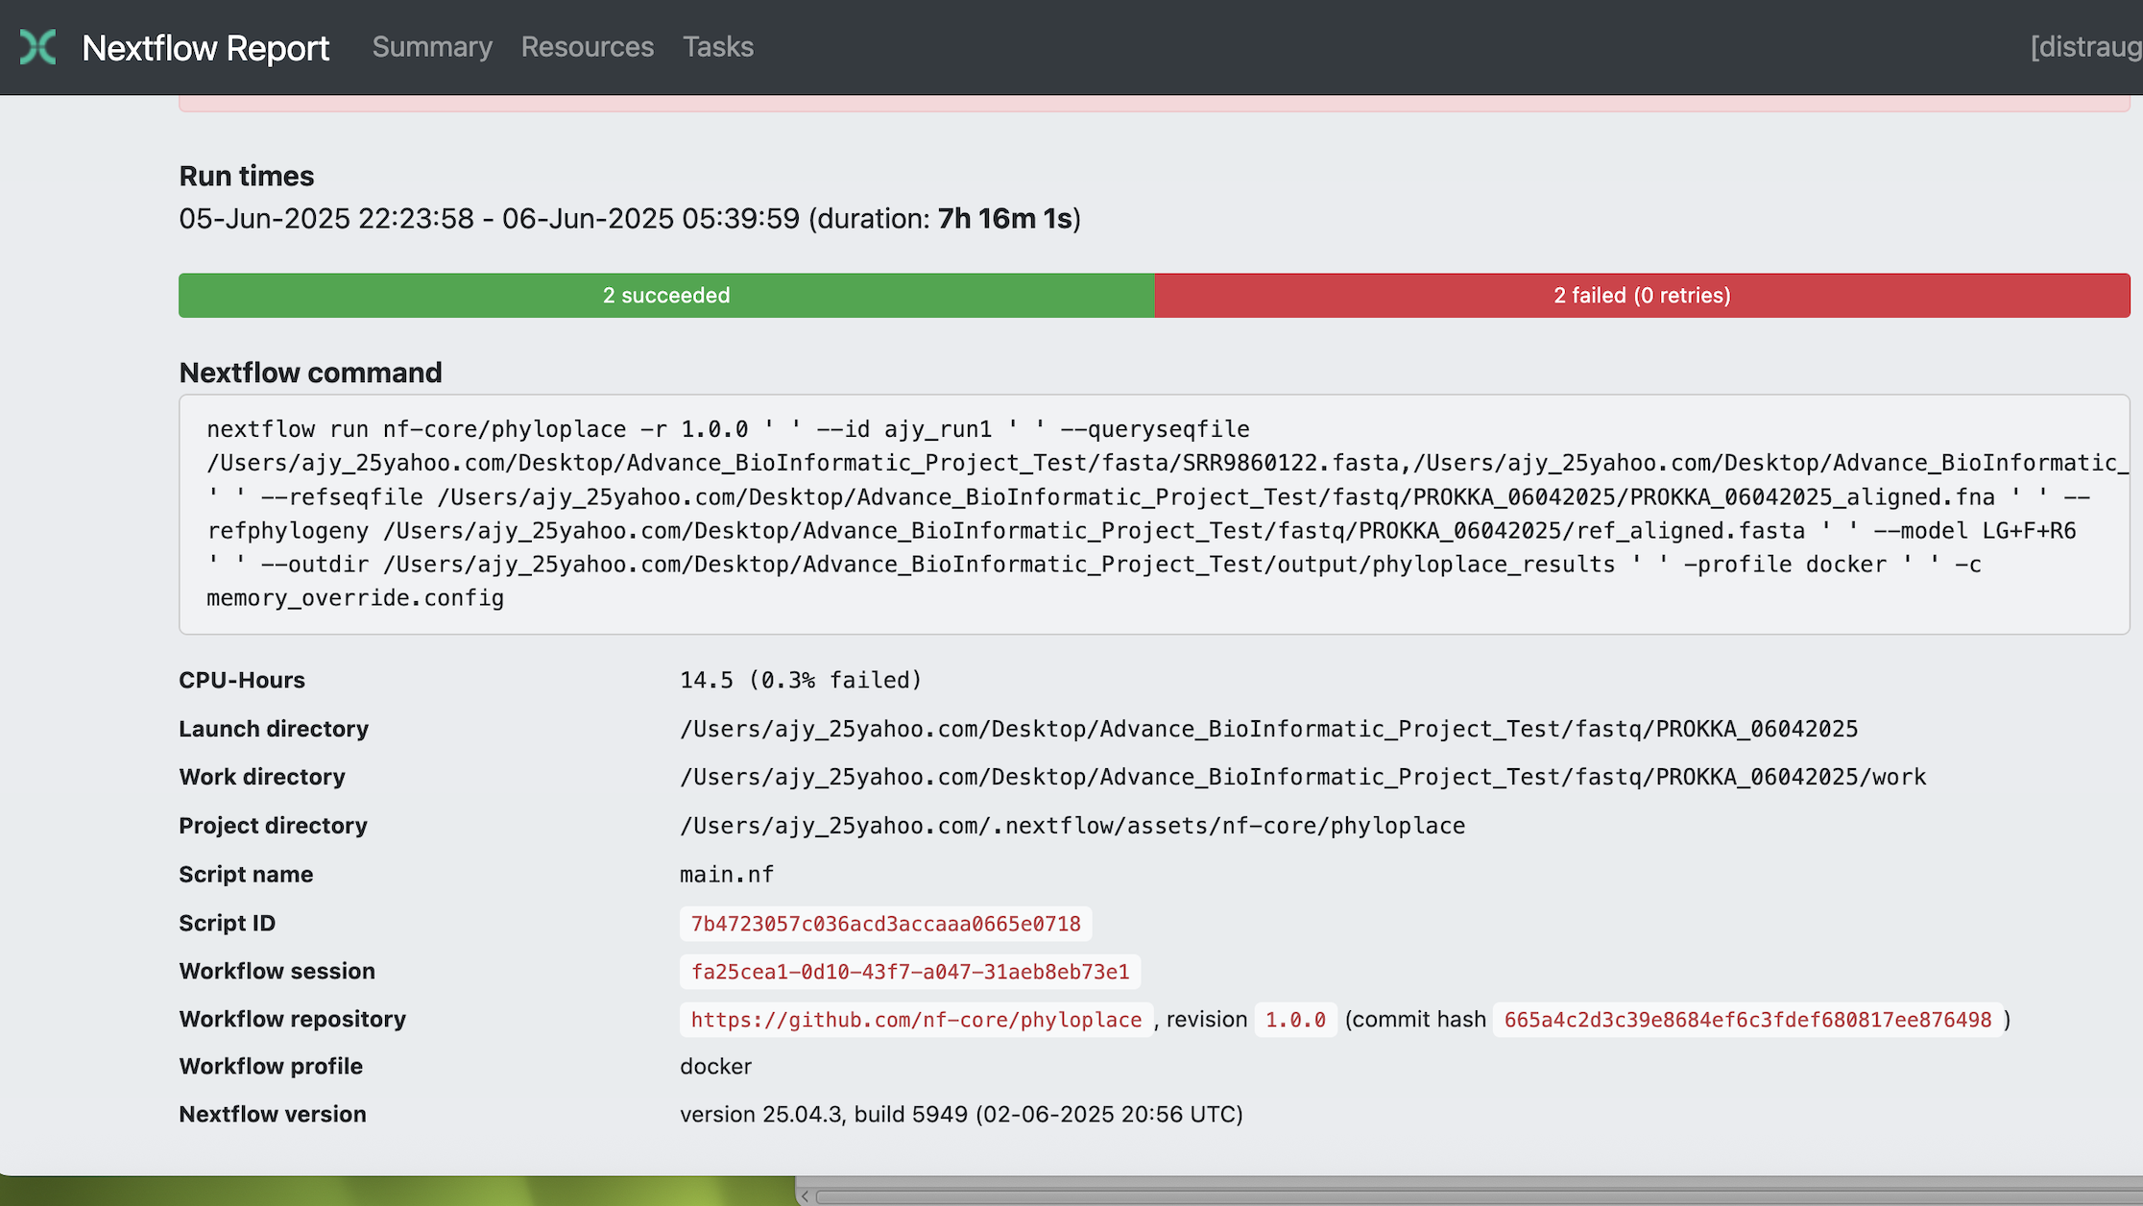

Slide 16
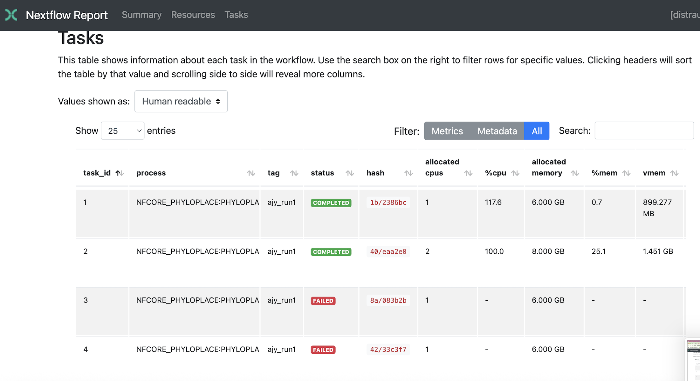

Slide 17
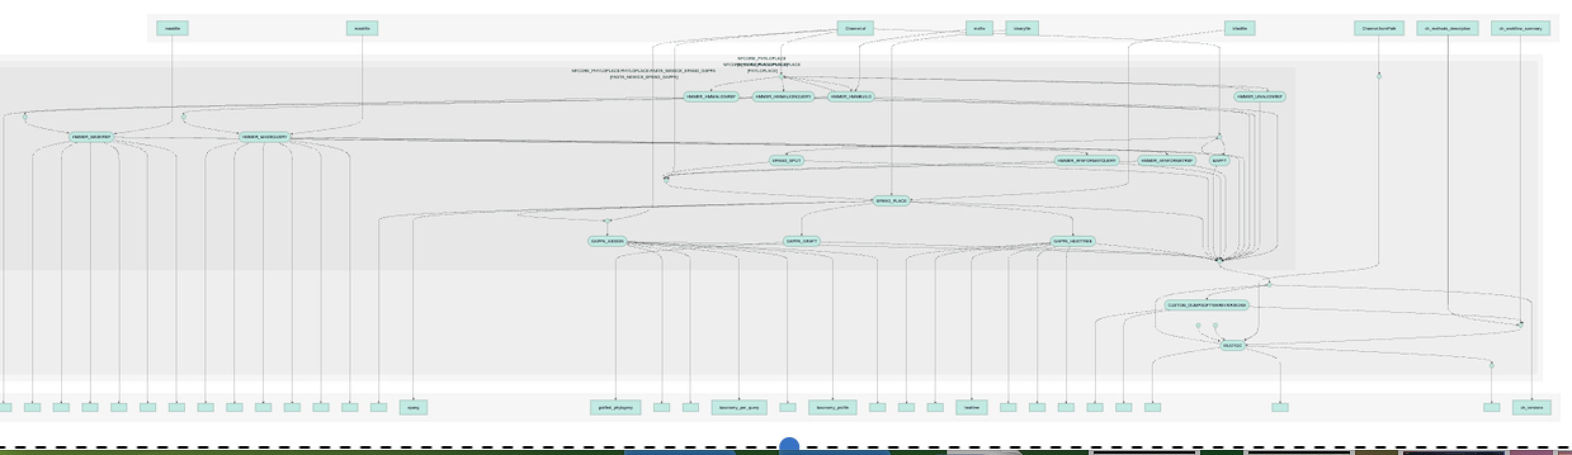

Slide 18
The tools were successfully executed:
FASTQC, PROKKA and BLAST+

Slide 19
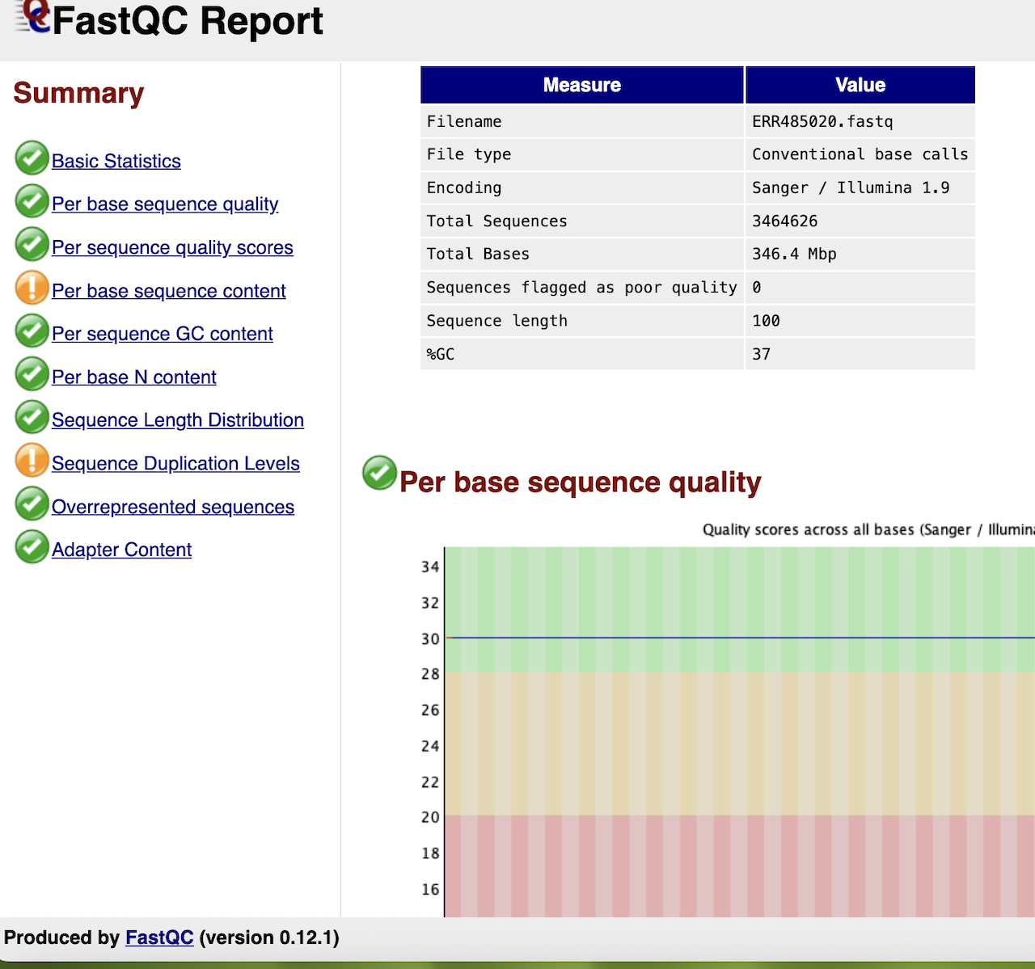
Quality Control
open /Users/ajy_25yahoo.com/Desktop/Advance_BioInformatic_Project_Test/fastq/SRR10240887_fastqc.html

Slide 20
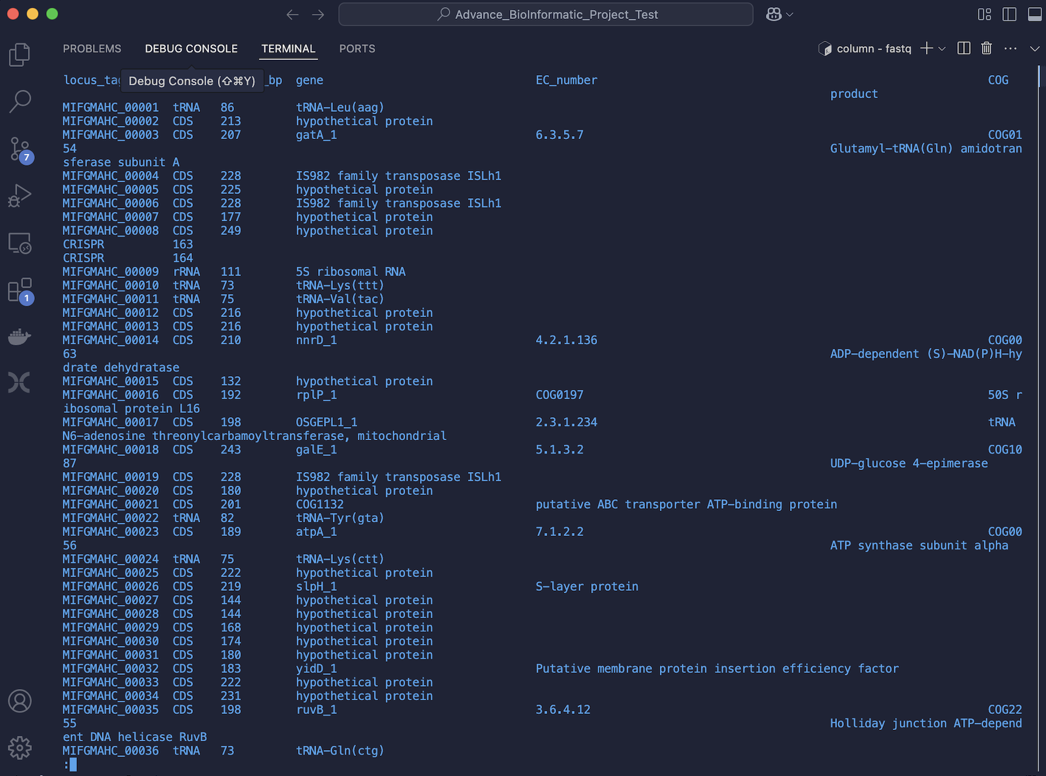
Genome Annotation using PROKKA
prokka --outdir PROKKA_run2 /Users/ajy_25yahoo.com/Desktop/Advance_BioInformatic_Project_Test/fastq/SRR9860122_unique.fasta

Slide 21
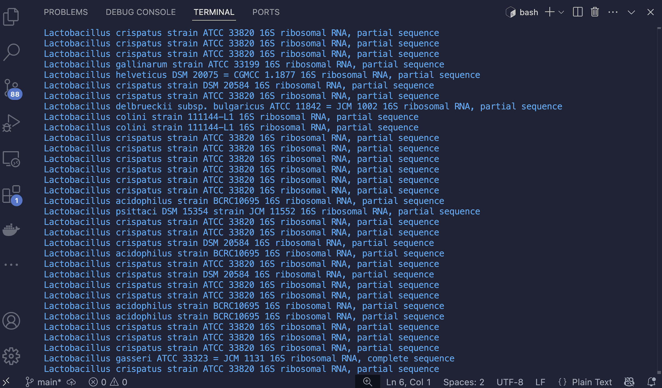
Sequence Type Identification from BLAST+
blastn -query fasta/SRR9860122.fasta -db 16S_ribosomal_RNA -out seqtype_SRR9860122.txt -outfmt "6 qseqid sseqid pident length evalue bitscore stitle" -max_target_seqs 5 -num_threads 2

Slide 22
Summary Sequence Type BLAST+
Genome ID | Species Name | Sequence Type
ERR485020 | Lactobacillus crispatus | 16S rRNA gene
SRR9860122 | Lactobacillus xujianguonis | 16S rRNA gene
SRR10240887 | Lactobacillus xujianguonis | 16S rRNA gene

Slide 23
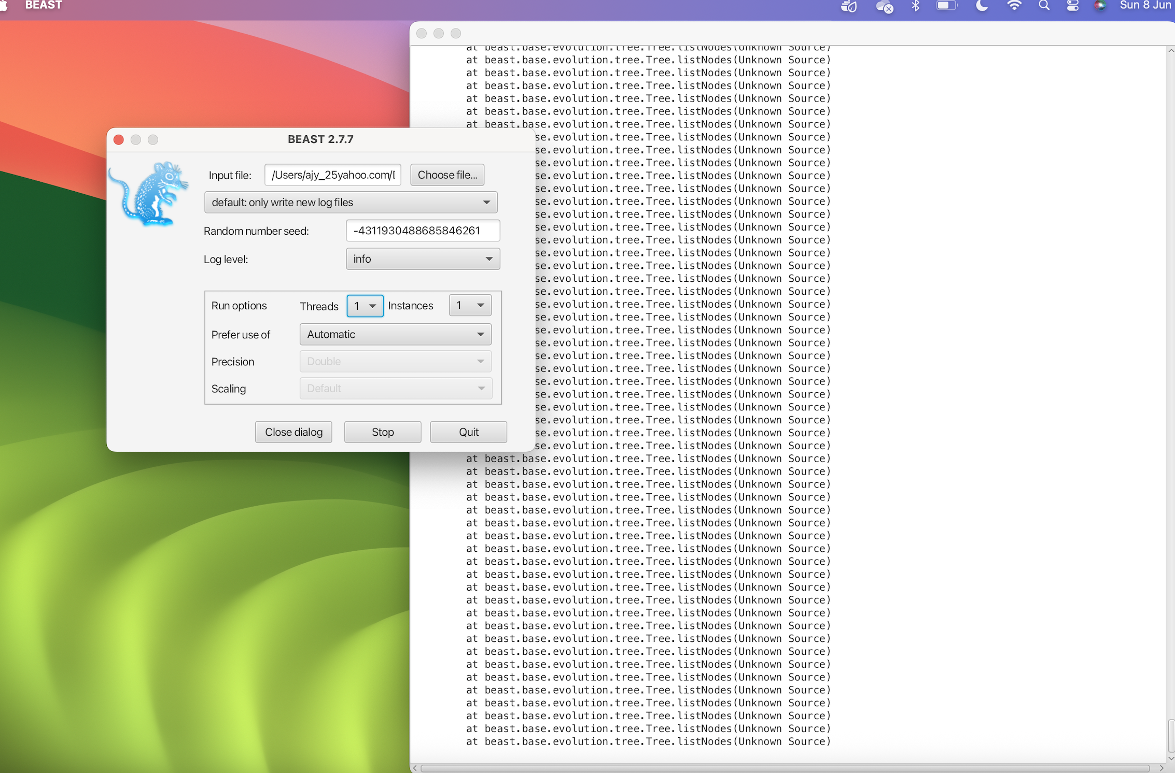
BEAST

Slide 24
Discussion
This study attempted to run the nf-core/phyloplace pipeline for phylogenetic placement but faced technical difficulties that prevented successful execution.
However, genome annotation, sequence quality assessment and sequence typing were completed successfully using PROKKA, FastQC and BLAST+ tools.
The project also established a remote GitHub repository where codes and files were deposited to track the progress of the bioinformatics research.

Slide 25
Future Directions
Re-retry running the nf-core/phyloplace pipeline with corrected commands, following nf-core guidelines precisely.
Optimize nf-core/phyloplace workflow by properly configuring the environment, verifying input file compatibility, and using cloud computing if local resources are limited.
Test other phylogenetic pipelines, such as BEAST, PhyloPhlAn and IQ-TREE.
Conduct further bioinformatic analysis, including antimicrobial resistance screening, to deepen genomic insights.

Slide 26
Limitations and Caveats
Pipeline Execution: The nf-core/phyloplace pipeline failed to run successfully, restricting phylogenetic analysis and interpretation of evolutionary relationships.
Sample Size: Because of possible space and memory constraints on laptop, only 3 samples were analyzed, limiting statistical reliability and generalizability of phylogenetic conclusions.
Lack of Published Validation: No peer-reviewed studies were found using the nf-core/phyloplace pipeline, limiting confidence in its validation and scientific applicability.

Slide 27
References
Ewels PA, Peltzer A, Fillinger S, Patel H, Alneberg J, Wilm A, Garcia MU, Di Tommaso P, Nahnsen S. The nf-core framework for community-curated bioinformatics pipelines. Nat Biotechnol. 2020 Mar;38(3):276-278.
https://github.com/nf-core/phyloplace
https://github.com/uleth-advanced-bioinformatics/BCHM5420A-summer-2025
Petit RA 3rd, Read TD. Bactopia: a Flexible Pipeline for Complete Analysis of Bacterial Genomes. mSystems. 2020 Aug 4;5(4):e00190-20.

Slide 28
Thank You.
Questions?

Slide 29
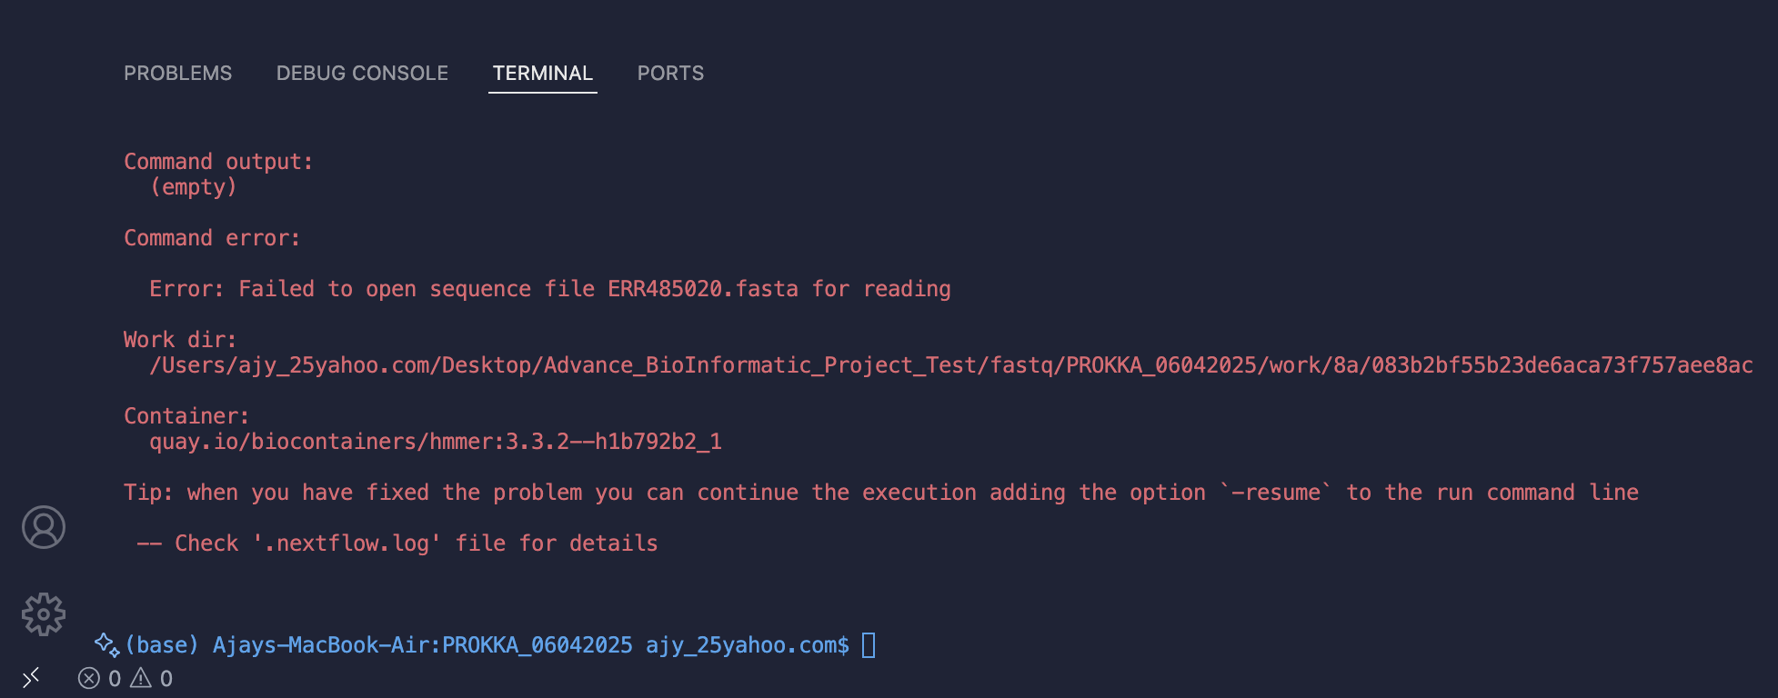

Slide 30
Discussion

Slide 31
In conclusion,
This study presented the nf-core/phylo pipeline for generating phylogenetic tree of Lactobacillus whole genome data produced by illumina technologies.
Despite some errors encountered, the pipeline may have best practicr analysis for phylogenesis.

Slide 32
nextflow run nf-core/phyloplace -r 1.0.0
-id ajy_run1
Assigns an ID/name to my run. Useful to identify outputs and logs related to this particular execution.
3.--queryseqfile '/path/to/SRR9860122.fasta,/path/to/ERR485020.fasta'
This is my query sequences file(s).
I gave two FASTA files separated by a comma inside one string.
4. --refseqfile '/path/to/PROKKA_06042025_aligned.fna'
This is the reference sequence file, a multiple sequence alignment (MSA) of known lactobacillus sequences.
query sequences will be compared/placed against this reference.
5. --refphylogeny '/path/to/ref_aligned.fasta’
This is the reference phylogeny tree file.
The pipeline will use this tree to place your query sequences into the phylogenetic context.

Slide 33
nextflow run nf-core/phyloplace -r 1.0.0 \ --id ajy_run1 \
--queryseqfile '/Users/ajy_25yahoo.com/Desktop/Advance_BioInformatic_Project_Test/fasta/SRR9860122.fasta,
/Users/ajy_25yahoo.com/Desktop/Advance_BioInformatic_Project_Test/fasta/ERR485020.fasta' \
--refseqfile '/Users/ajy_25yahoo.com/Desktop/Advance_BioInformatic_Project_Test/fastq/PROKKA_06042025/PROKKA_06042025_aligned.fna' \
--refphylogeny '/Users/ajy_25yahoo.com/Desktop/Advance_BioInformatic_Project_Test/fastq/PROKKA_06042025/ref_aligned.fasta' \
--model LG+F+R6 \
--outdir /Users/ajy_25yahoo.com/Desktop/Advance_BioInformatic_Project_Test/output/phyloplace_results \ -profile docker \ -c memory_override.config
nextflow run nf-core/phyloplace -r 1.0.0 \
--id ajy_run1 \
--queryseqfile '/Users/ajy_25yahoo.com/Desktop/Advance_BioInformatic_Project_Test/fasta/SRR9860122.fasta,/Users/ajy_25yahoo.com/Desktop/Advance_BioInformatic_Project_Test/fasta/ERR485020.fasta' \
--refseqfile '/Users/ajy_25yahoo.com/Desktop/Advance_BioInformatic_Project_Test/fastq/PROKKA_06042025/PROKKA_06042025_aligned.fna' \
--refphylogeny '/Users/ajy_25yahoo.com/Desktop/Advance_BioInformatic_Project_Test/fastq/PROKKA_06042025/ref_aligned.fasta' \
--model LG+F+R6 \
--outdir '/Users/ajy_25yahoo.com/Desktop/Advance_BioInformatic_Project_Test/output/phyloplace_results' \
-profile docker \
-c memory_override.config

Slide 34
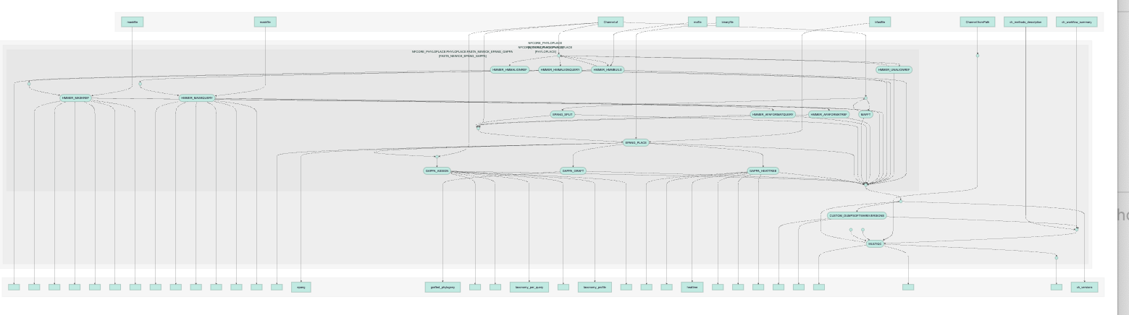

Slide 35
6. -model LG+F+R6
This specifies the evolutionary model for sequence analysis.
LG+F+R6 is a common substitution model for protein sequences.
The pipeline will use this model during phylogenetic placement.
7. --outdir '/path/to/phyloplace_results'
Directory where all output files will be saved.
8. -profile docker
Tells Nextflow to use the Docker container environment to run the pipeline.
9. -c memory_override.config
Loads a custom Nextflow config file named memory_override.config.
Usually used to override default resource settings like memory, CPU, or runtime for certain steps.
Note: continuation character \
The backslash \ at the end of each line tells the shell that the command continues on the next line.
It improves readability for long commands.

Slide 36
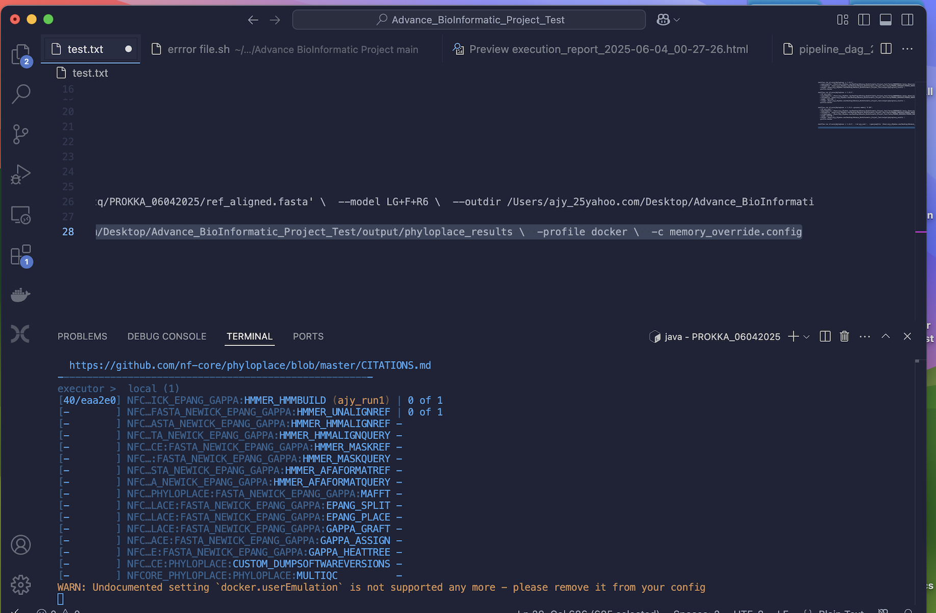
Run

Slide 37
Limitations and Caveats
There are many limitations and caveats to this study
Sample size: This project used only 2 lactobacillus query sequence and one lactobacillus refrence sequence, which is too small to make any meaningful conclusion from.
When running the pipeline: software version was one issue
Conclusions
The realiabilut of nf phylo to construct

